Slide 1
Arithmetic Operations

Slide 2
Outline
Arithmetic Operations
  Unsigned addition, multiplication
  Signed addition, negation, multiplication
  Using Shift to perform power-of-2 multiply
Suggested reading
  Chap 2.3

Slide 3
Unsigned Addition
u
• • •
Operands: w bits
+
v
• • •
True Sum: w+1 bits
u + v
• • •
Discard Carry: w bits
UAdd_{w}(u , v)
• • •

Slide 4

Unsigned Addition
Standard Addition Function
  Ignores carry output
Implements Modular Arithmetic
  s = UAddw(u , v) = (u + v) mod 2^{w}

Slide 5
Unsigned Addition
Practice Problem 2.27
Write a function with the following prototype:
/* Determine whether arguments can be added without overflow */
int uadd_ok(unsigned x, unsigned y);
This function should return 1 if arguments x and y can be added without causing overflow
  Overflow iff (X+Y) < X

Slide 6
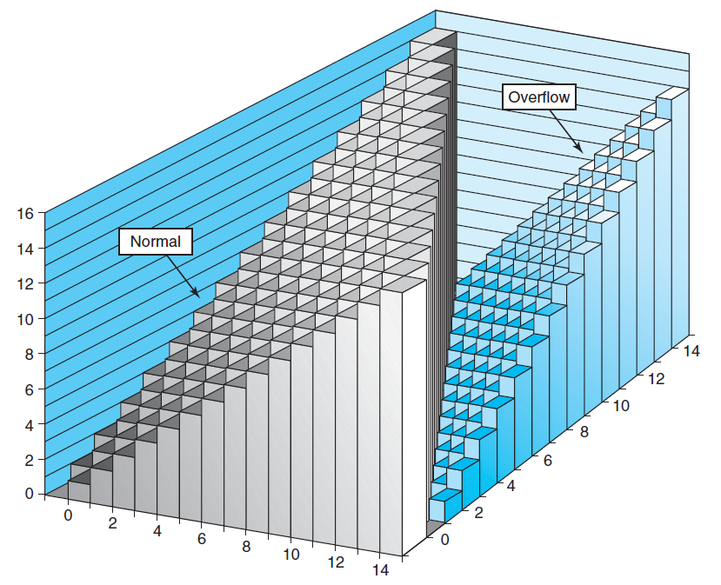
Unsigned Addition

Slide 7
Unsigned Addition Forms an Abelian Group
Closed under addition
  0 ≤ UAdd_{w}(u , v) ≤ 2^{w} –1
Associative
  UAdd_{w} (t, UAdd_{w} (u,v)) = UAdd_{w} (UAdd_{w} (t, u ), v)
0 is additive identity
  UAdd_{w} (u , 0) = u

Slide 8
Unsigned Addition Forms an Abelian Group
Every element has additive inverse
  Let UComp_{w} (u ) = 2^{w} – u
  UAddw(u , UComp_{w} (u )) = 0
Commutative
  UAdd_{w}(u , v) = UAdd_{w}(v , u)

Slide 9
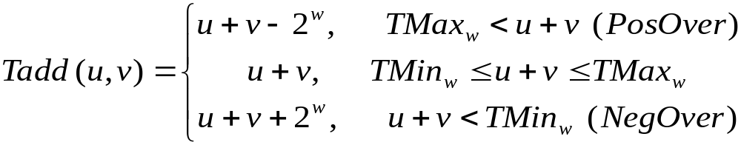
Signed Addition
Functionality
  True sum requires w+1 bits
  Drop off MSB
  Treat remaining bits as 2’s comp. integer

Slide 10
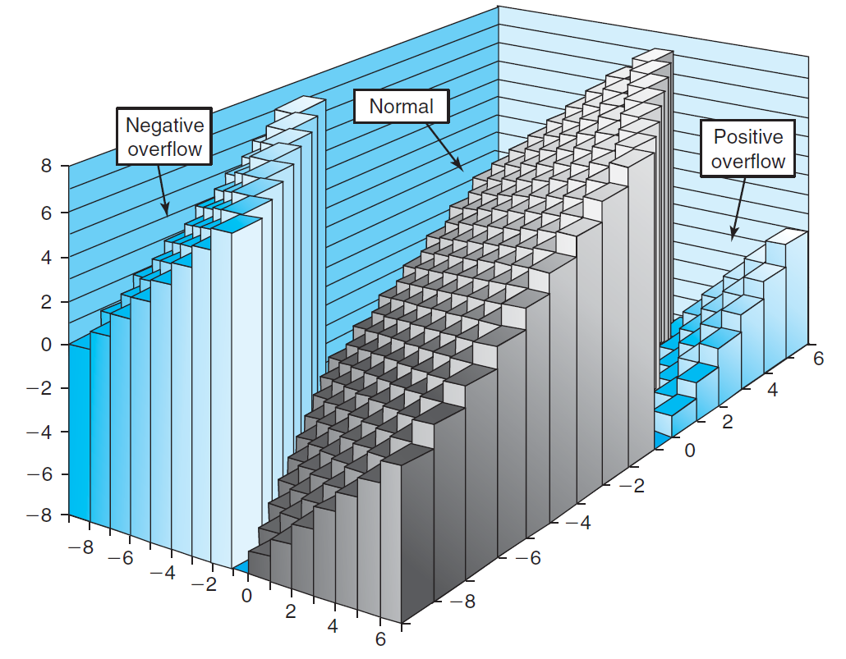
Signed Addition

Slide 11
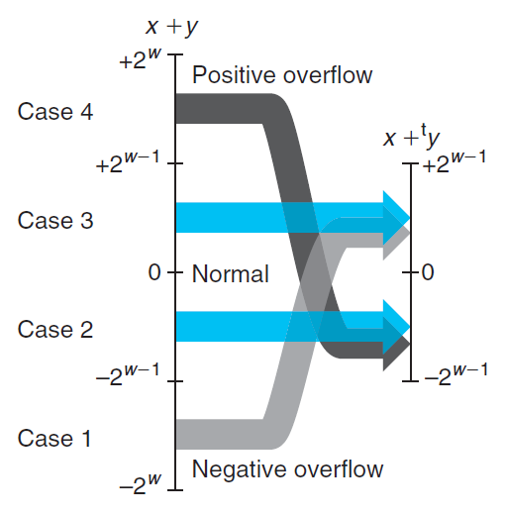
Signed Addition

Slide 12
Detecting Tadd Overflow
Task
  Given s = TAdd_{w}(u , v)
  Determine if s = Add_{w}(u , v)
Claim
  Overflow iff either:
    u, v < 0, s ≥ 0 (NegOver)
    u, v ≥ 0, s < 0 (PosOver)
  ovf = (u<0 == v<0) && (u<0 != s<0);

Slide 13
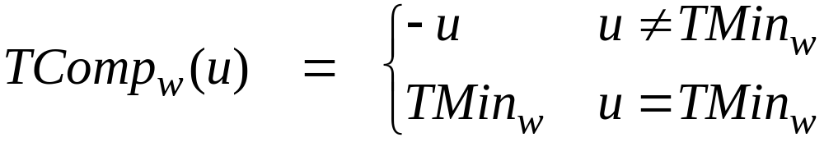
Mathematical Properties of TAdd
Two’s Complement Under TAdd Forms a Group
  Closed, Commutative, Associative, 0 is additive identity
  Every element has additive inverse
    Let
    TAdd_{w}(u , TComp_{w} (u )) = 0

Slide 14
Detecting Tadd Overflow
int tadd_ok_bugy(int x, int y)
{
int sum = x + y ;
return (sum-x == y) && (sum-y == x)
}
Abelian group(x+y-x=y+x-x, always true)
int tsub_ok_bugy(int x, int y)
{
return tadd_ok(x, -y) ;
}
Set y to TMIN, -y is also TMIN. If x is negative, add will always overflow, sub will not.

Slide 15
Mathematical Properties of TAdd
Isomorphic Algebra to UAdd
  TAdd_{w} (u , v) = U2T (UAdd_{w}(T2U(u ), T2U(v)))
    Since both have identical bit patterns
  T2U(TAdd_{w} (u , v)) = UAdd_{w}(T2U(u ), T2U(v))

Slide 16
Negating with Complement & Increment
x
1
0
0
1
1
1
0
1
In C
  ~x + 1 == -x
Complement
  Observation: ~x + x == 1111…111 == -1
Increment
  ~x + x + (-x + 1) == -1 + (-x + 1)
  ~x + 1 == -x
+
~x
0
1
1
0
0
0
1
0
-1
1
1
1
1
1
1
1
1

Slide 17
Multiplication
Computing Exact Product of w-bit numbers x, y
  Either signed or unsigned
Ranges
  Unsigned: 0 ≤ x * y ≤ (2^{w} – 1) ² = 2^{2w} – 2^{w+1} + 1
    Up to 2w bits
  Two’s complement min: x *y ≥–2^{w–1}*(2^{w–1}–1) = –2^{2w–2} + 2^{w–1}
    Up to 2w–1 bits
  Two’s complement max: x * y ≤ (–2^{w–1}) ² = 2^{2w–2}
    Up to 2w bits, but only for TMinw²

Slide 18
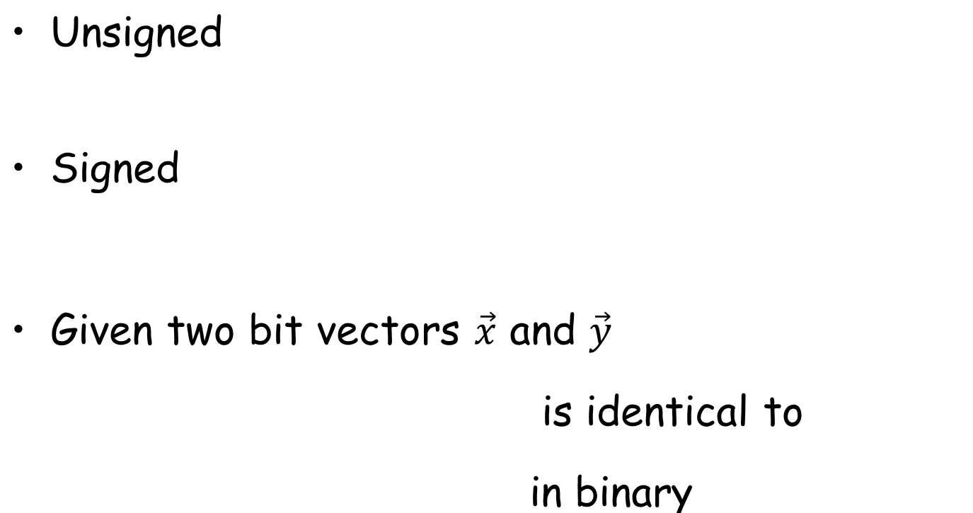





Multiplication

Slide 19
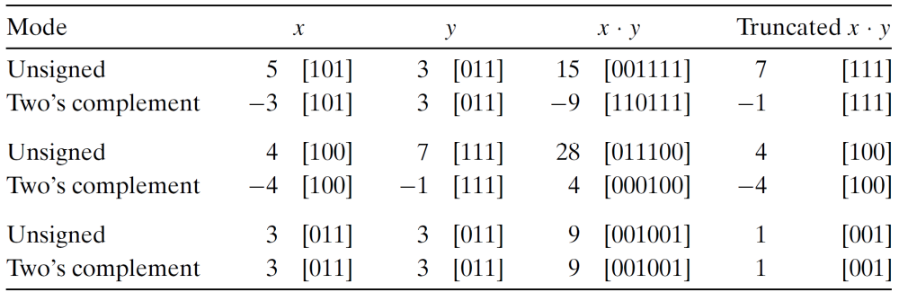
Multiplication
Maintaining Exact Results
  Would need to keep expanding word size with each product computed
  Done in software by “arbitrary precision” arithmetic packages

Slide 20
Multiplication
Maintaining Exact Results
  Would need to keep expanding word size with each product computed
  Done in software by “arbitrary precision” arithmetic packages

Slide 21
Power-of-2 Multiply with Shift
k
u
• • •
Operands: w bits
*
2^{k}
0
•••
0
1
0
•••
0
0
True Product: w+k bits
u · 2^{k}
• • •
0
•••
0
0
Discard k bits: w bits
UMult_{w}(u , 2^{k})
•••
0
•••
0
0
TMult_{w}(u , 2^{k})

Slide 22
Power-of-2 Multiply with Shift
Operation
  u << k gives u * 2^{k}
  Both signed and unsigned
Examples
  u << 3 == u * 8
  u << 5 - u << 3 == u * 24
  Most machines shift and add much faster than multiply
    Compiler will generate this code automatically

Slide 23
Security Vulnerability in the XDR Library
1 /*
2 * Illustration of code vulnerability similar to that found in
3 * Sun’s XDR library.
4 */

Slide 24
Security Vulnerability in the XDR Library
5 void* copy_elements(void *ele_src[], int ele_cnt, size_t ele_size) {
6 /*
7 * Allocate buffer for ele_cnt objects, each of ele_size bytes
8 * and copy from locations designated by ele_src
9 */
10 void *result = malloc(ele_cnt * ele_size);
11 if (result == NULL)
12 /* malloc failed */
13 return NULL;

Slide 25
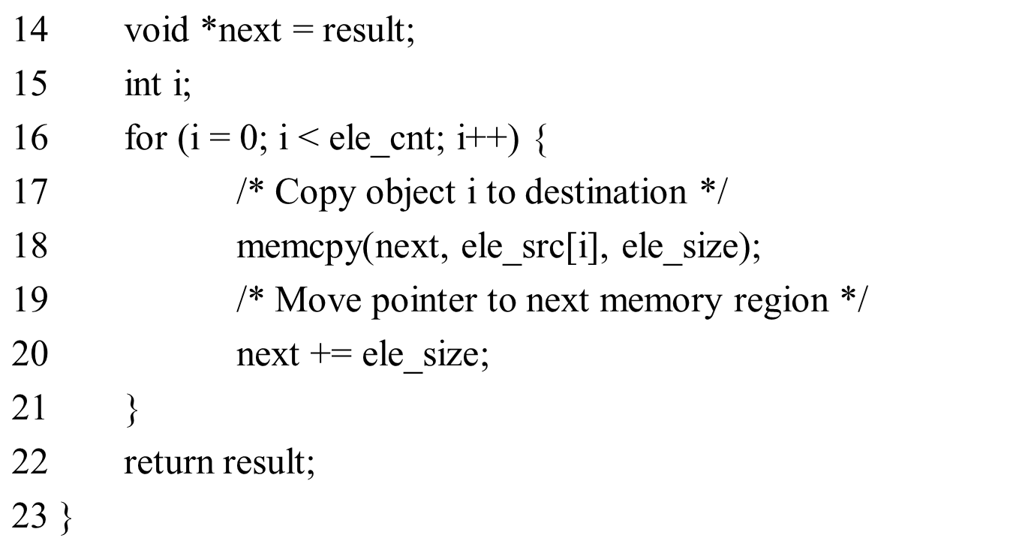
Security Vulnerability in the XDR Library

